Slide 1
Lecture 4: Software Process Models
based on Chapter 4

Slide 2
Why Process models?
Provide guidance for a systematic coordination and controlling of the tasks and of the personnel who performs the tasks
Note the key words: coordination , tasks, people

Slide 3
Process model
Defines the set of tasks that need to be performed
Defines the input and the output from these tasks
Defines the pre-condition and post-conditions for each task
Defines the sequence of flow of the tasks
May include a description of who performs it.

Slide 4
Software Process
Process is distinct from product – products are outcomes of executing a process on a project
SW Engineering focuses on process
Premise: Proper processes will help achieve project objectives of high QP
Sofware Process

Slide 5
Software Process…
Process: A particular method, generally involving a number of steps
Software Process: A set of steps, along with ordering constraints on execution, to produce software with desired outcome
Many types of activities performed by different people in a software project
Better to view software process as comprising of many component processes
Sofware Process

Slide 6
Component Software Processes
Two major processes
  Development – focuses on development and quality steps needed to engineer the software
  Project management – focuses on planning and controlling the development process
Development process is the heart of software process; other processes revolve around it
These are executed by different people
  developers execute engineering. Process
  project manager executes the management processes
Sofware Process

Slide 7
Component Processes…
Other processes
  Configuration management process: manages the evolution of artifacts
  Change management process: how changes are incorporated
  Process management process: management of processes themselves
  Inspection process: How inspections are conducted on artifacts
Sofware Process

Slide 8
Process Specification
Process is generally a set of phases
Each phase performs a well defined task and generally produces an output
Intermediate outputs – work products
At top level, typically few phases in a process
How to perform a particular phase – methodologies have been proposed
Sofware Process

Slide 9
Desired Process Properties
Provide high Q&P
  Support testability as testing is the most expensive task; testing can consume 30 to 50% of total development effort
  Support maintainability as maintenance can be more expensive than development; over life up to 80% of total cost
  Remove defects early, as cost of removing defects increases with latency
Sofware Process

Slide 10
High Q&P: Early Defect Removal…
Cost of a defect increases with latency
I.e. fixing a requirement defect in operation can cost a 100 times the cost of fixing it in requirements itself
Hence, for high Q&P, the process must support early defect removal
That is why there is a V in ETVX (Entry, Task, Verification, Exit), and quality control tasks in the sw process
Sofware Process

Slide 11
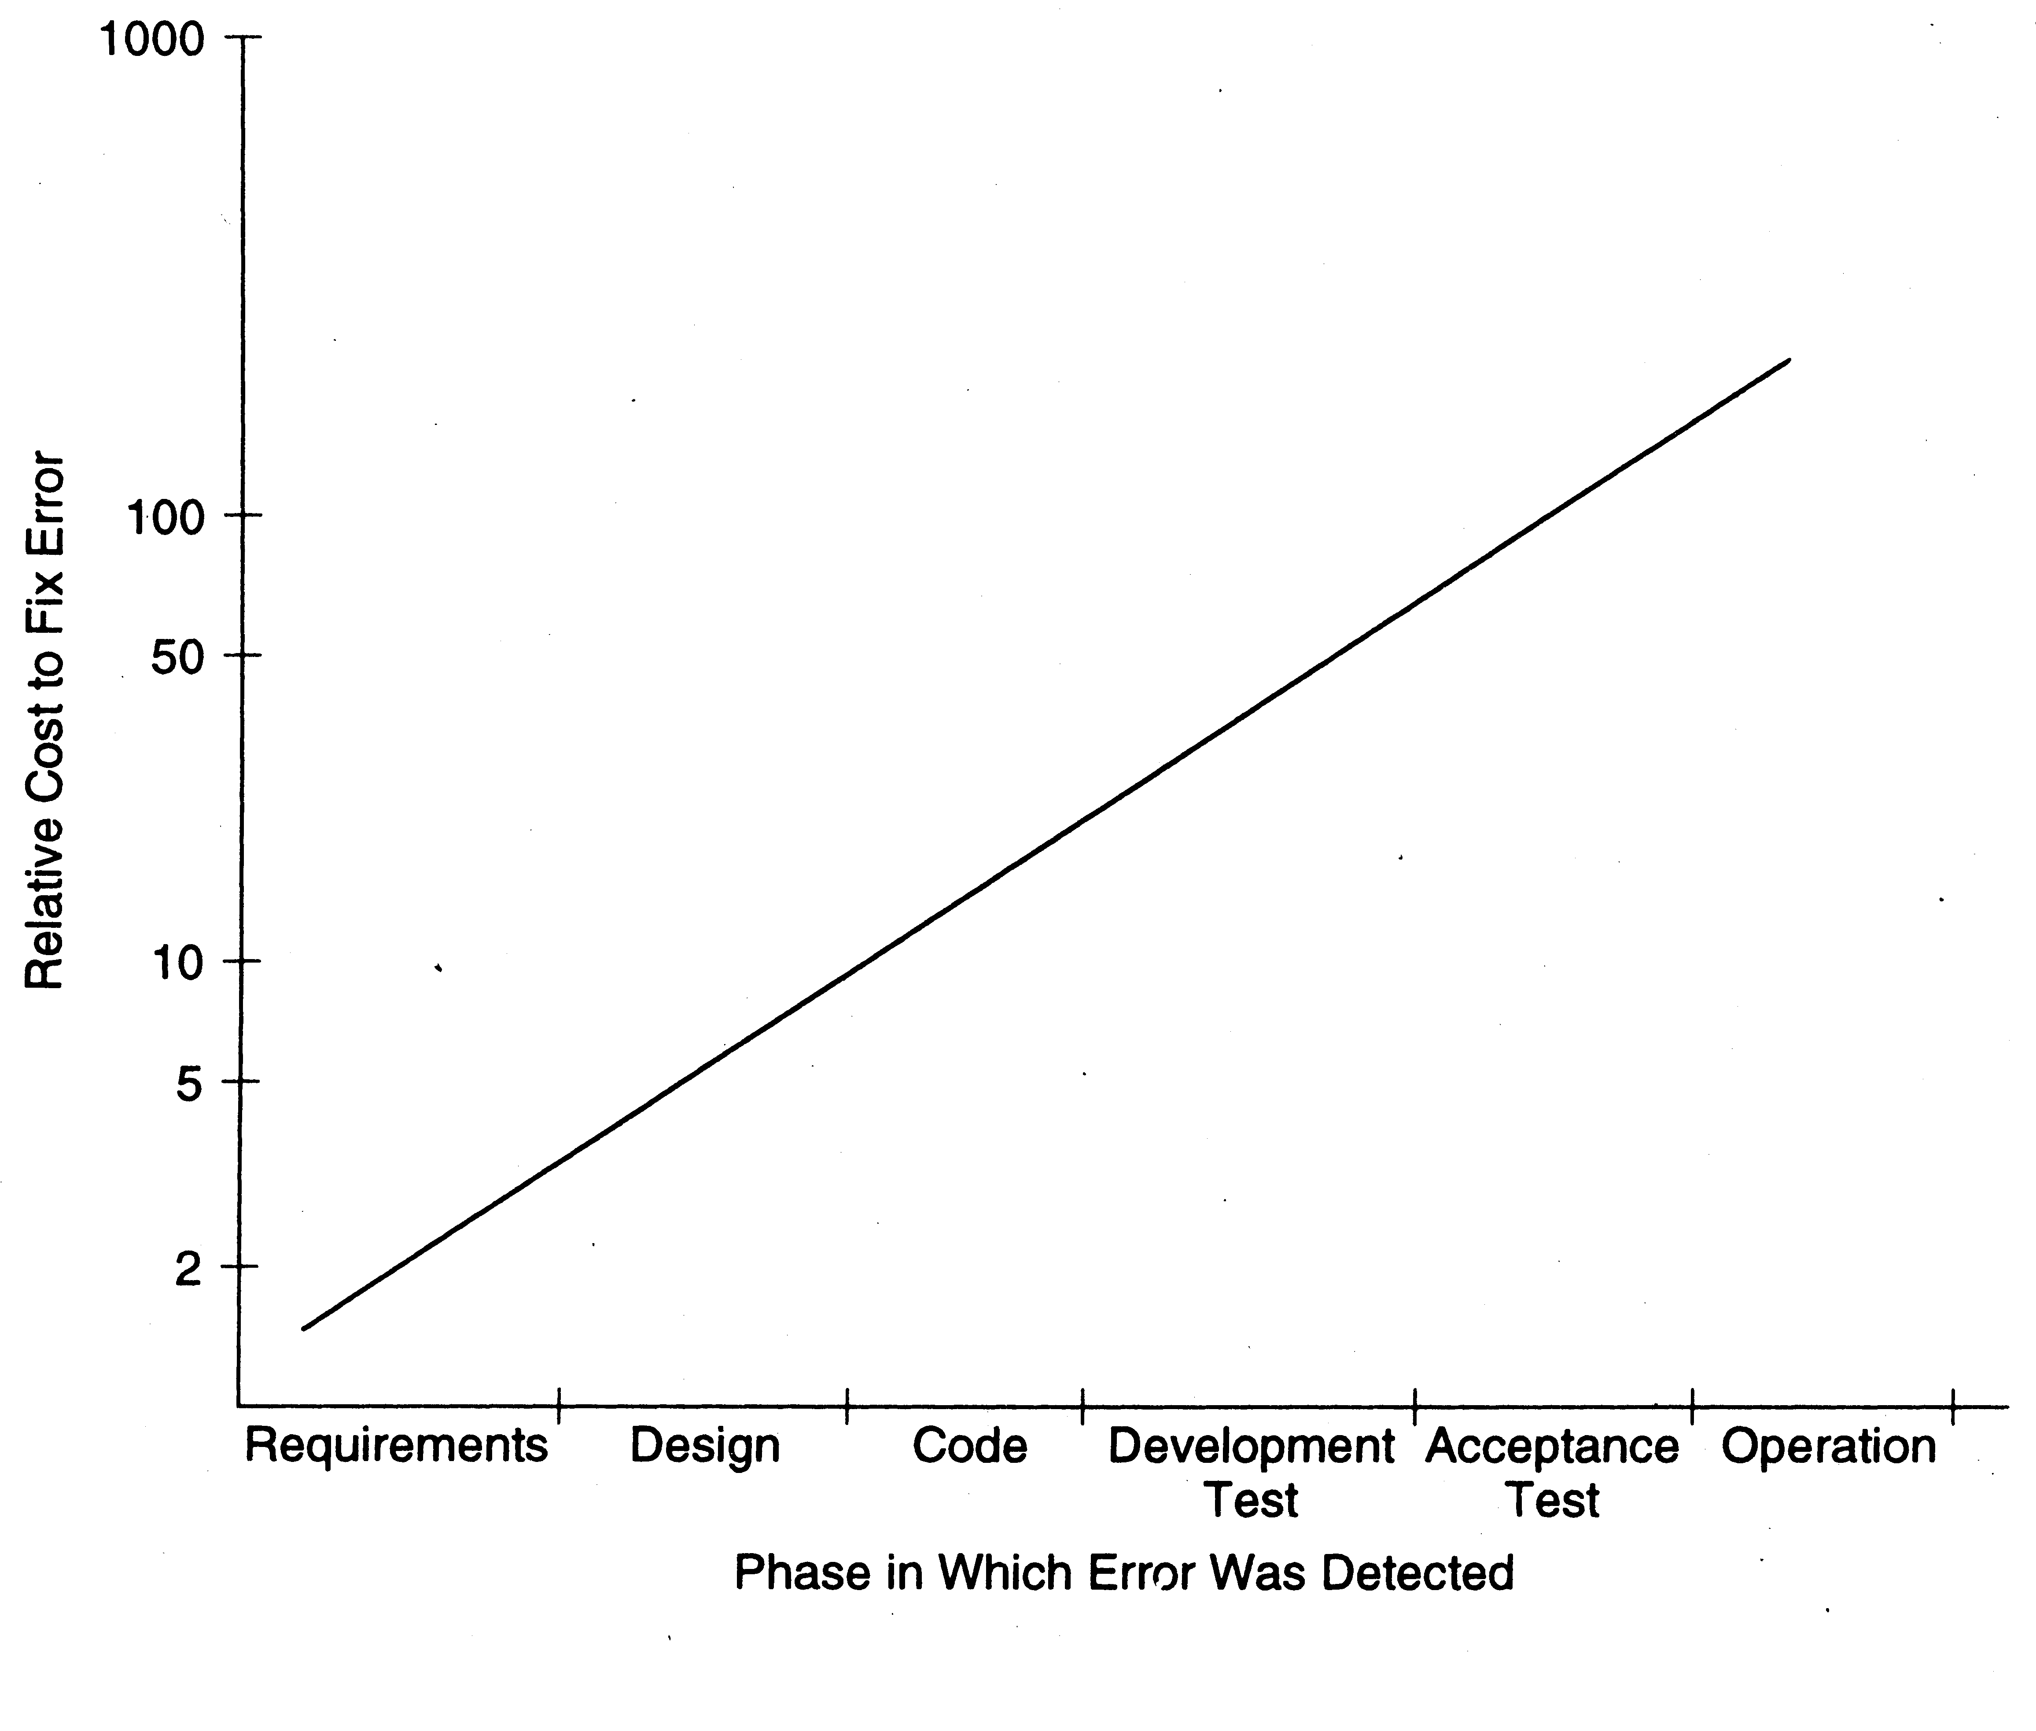
Early Defect Removal…
Sofware Process

Slide 12
Desired Properties…
Predictability and repeatability
  Process should repeat its performance when used on different projects
  I.e. outcome of using a process should be predictable
  Without predictability, cannot estimate, or say anything about quality or productivity
  With predictability, past performance can be used to predict future performance
Sofware Process

Slide 13
Predictability…
Predictable process is said to be under statistical control
  Repeatedly using the process produces similar results
  Results – properties of interest like quality, productivity, …
To consistently develop sw with high Q&P, process must be in control
Sofware Process

Slide 14
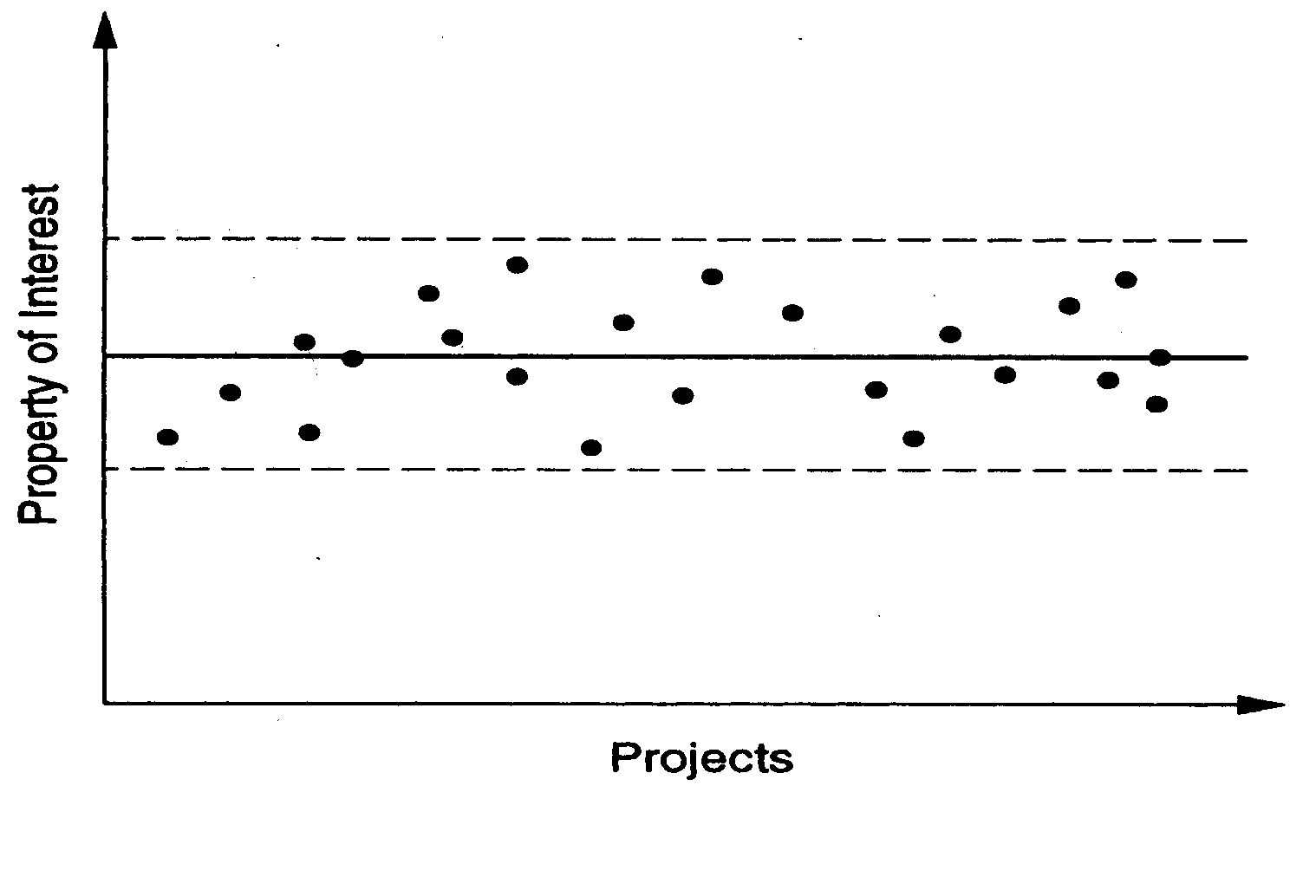
Predictability…
Sofware Process

Slide 15
Support Change
Software changes for various reasons
Requirements change is a key reason
Requirement changes cannot be wished away or treated as “bad”
They must be accommodated in the process for sw development
Sofware Process

Slide 16
Summary
Process – method for doing something
Process typically has stages, each stage focusing on an identifiable task
Stages have methodologies
Software process is the methods for developing software
Best to view it as comprising of multiple processes
Sofware Process

Slide 17
Summary
Goal is to produce software with high quality and productivity
Process is the means
Development process is central process
Mgmt process is for controlling dev
Other supporting processes
Sw process should have high Q&P, predictability, and support for change
Sofware Process

Slide 18
Development Process and Process Models
Sofware Process

Slide 19
Software Project
Project – to build a software system within cost and schedule and with high quality which satisfies the customer
Project goals – high Q and high P
Suitable process needed to reach goals
For a project, the process to be followed is specified during planning
Sofware Process

Slide 20
Development Process
A set of phases and each phase being a sequence of steps
Sequence of steps for a phase - methodologies for that phase.
Why have phases
  To employ divide and conquer
  each phase handles a different part of the problem
  helps in continuous validation
Sofware Process

Slide 21
Development Process
Commonly has these activities:
  Requirements analysis
  Design (including Architecture)
  Coding
  Testing
  Delivery
Different models perform them in different manner
Sofware Process

Slide 22
Requirement Analysis
To understand and state the problem precisely
Forms the basis of agreement between user and developer
specifies “ what “ , not “ how “.
Not an easy task, as needs often not understood.
Requirement specifications of even medium systems can be many hundreds of pages
Output is the Software Requirements Specification (SRS) document
Sofware Process

Slide 23
Design
A major step in moving from problem domain to solution domain; three main tasks
  Architecture design – components and connectors that should be there in the system
  High level design – modules and data structures needed to implement the architecture
  Detailed design – logic of modules
Most methodologies focus on architecture or high level design
Outputs are architecture/design/logic design documents
Sofware Process

Slide 24
Coding
Converts design into code in specific language
Goal: Implement the design with simple and easy to understand code.
  Code should be simple and readable.
The coding phase affects both testing and maintenance. Well written code can reduce the testing and maintenance effort.
Output is code
Sofware Process

Slide 25
Testing
Defects are introduced in each phase
They have to be found and removed to achieve high quality
Testing plays this important role
Goal: Identify most of defects
Is a very expensive task; has to be properly planned and executed.
Outputs are Test plans/results, and the final tested (hopefully reliable) code
Sofware Process

Slide 26
Effort Distribution
Distribution of effort :
  Requirements 10-20%
  Design 10-20%
  Coding 20-30%
  Testing 30-50%
Coding is not the most expensive.
Sofware Process

Slide 27
Distribution of effort…
How programmers spend their time
  Writing programs 13%
  Reading programs and manuals 16%
  Job communication 32%
  Others 39%
Programmers spend more time in reading programs than in writing them.
Writing programs is a small part of their lives.
Sofware Process

Slide 28
Defects
Distribution of error occurrences by phase is
  Req. - 20%
  Design - 30%
  Coding - 50%
Defects can be injected at any of the major phases.
Cost of latency: Cost of defect removal increases exponentially with latency time.
Sofware Process

Slide 29
Defects…
      Cost to fix
      Error ( log scale)
      Time
Cheapest way is to detect and remove defects close to where it is injected.
Hence must check for defects after every phase.
Sofware Process

Slide 30
Process Models
A process model specifies a general process, usually as a set of stages
This model will be suitable for a class of projects
I.e. a model provides generic structure of the process that can be followed by some projects to achieve their goals
Sofware Process

Slide 31
Projects Process
If a project chooses a model, it will generally tailor it to suit the project
This produces the spec for the projects process
This process can then be followed in the project
I.e. process is what is actually executed; process spec is plan about what should be executed; process model is a generic process spec
Many models have been proposed for the development process
Sofware Process

Slide 32
Typical Student Process Model
Get problem stmt – Code – do some testing – deliver/demo
Why this process model cannot be used for commercial projects?
  Produces student-software, which is not what we are after
  Cannot ensure desired quality for industrial-strength software
Sofware Process

Slide 33
Common Process Models
Waterfall – the oldest and widely used
Prototyping
Iterative – currently used widely
Timeboxing
Sofware Process

Slide 34
A Simple and Familiar Process
Problem
Statement
Unit Test
Code
Compile
Release
problem
problem
Debug
1. Most people perform and follow this process, but
unfortunately some skip unit testing or debugging.
2. Also, some proceed without clearly understanding the “problem statement” ---- which is requirements

Slide 35
Some “traditional” software development processes
The “simple” process was employed by many for years without formally embracing other important development activities such as requirements analysis, design, formal testing, or packaging.
The recognition of the need for formal processes was initially driven by failures in developing large complex software
  Waterfall : earliest process and coping with no process
  Incremental : coping with decomposing the large systems
  Spiral : coping with risk management
  Rational Unified Process : coping with multiple development and management issues

Slide 36
Waterfall Model
1. Requirements must be specified in the
first step.
2. Four main tasks must be completed in
sequence: requirements, design, code,
and test, followed by packaging.
3. Output of one stage feeds into the next
stage in sequence, and thus easily
tracked by management
Requirements
Design
Code
Test
Integrate and
Package

Slide 37
Incremental Model A – Continuous Integration
Each major requirement/item
is developed separately through
the same sequence of : requirement,
design, code, and unit test.
As the developed pieces are completed,
they are continuously merged and
integrated into a common bucket for
integrated system test
Req. 1
Req.2
. . .
Req. n
Des.
Des.
Des.
. . . .
code
code
code
. . . . . .
Test
Test
Test
System
Test
Integration Bucket

Slide 38
Incremental Model B - Multiple Release
Requirements
Design
Code
Test
Package
Rel. 1
.
.
.
Requirements
Design
Code
Test
Package
Rel. n
Each small set of requirements is developed,
packaged, and released in a multiple release
fashion.

Slide 39
Spiral Model
Determine Objectives,
Alternatives, Constraints
Evaluate Alternatives,
Identify, Resolve Risks
risk
analysis
design
model
proto
type
“Review”
req. plan
req.
Spec.
design
code
dev plan
design
validation
unit
test
test plan
sys.
test
Develop, Verify
Next-level Product
Plan Next Phase
- Software development
activities are cycled through
4 phases
- A Risk averse process

Slide 40
Spiral Model
Identify the objectives, alternatives, or constraints for each cycle of the spiral.
Evaluate the alternatives relative to the objectives and constraints. In performing this step, many of the risks are identified and evaluated.
Depending on the amount of and type of identidied risks, develop a prototype, more detailed evaluation, an evolutionary development, or some other step to further reduce risk of achieving the identified objective. On the other hand, if the risk is substantially reduced, the next step may just be a task such as requirements, design, or code.
Validate the achievement of the objective and plan for the next cycle.

Slide 41
RUP
The RUP is a phased model that identifies four discrete phases in the software process.
However, unlike the waterfall model where phases are equated with process activities, the phases in the RUP are more closely related to business rather than technical concerns
Iteration within the RUP is supported in two ways.
  Each phase may be enacted in an iterative way with the results developed incrementally.
  In addition, the whole set of phases may also be enacted incrementally

Slide 42

Phases in the Rational Unified Process

Slide 43
RUP phases
Inception
  Establish the business case for the system.
Elaboration
  Develop an understanding of the problem domain and the system architecture.
Construction
  System design, programming and testing.
Transition
  Deploy the system in its operating environment.

Slide 44
Rational Unified Process (RUP)
Phases
Activities
Inception
Elaboration
Construction
Transition
Requirements
Design
Implement
Test
Integrate
Every software development
activity goes through the 4
phases of inception, elaboration,
construction, and transition

Slide 45
RUP good practice
Develop software iteratively
  Plan increments based on customer priorities and deliver highest priority increments first.
Manage requirements
  Explicitly document customer requirements and keep track of changes to these requirements.
Use component-based architectures
  Organize the system architecture as a set of reusable components.

Slide 46
RUP good practice
Visually model software
  Use graphical UML models to present static and dynamic views of the software.
Verify software quality
  Ensure that the software meet’s organizational quality standards.
Control changes to software
  Manage software changes using a change management system and configuration management tools.

Slide 47
Entry and Exit Criteria
Process
Activity
Exit
Criteria
Met?
Entry
Criteria
Met?
Yes
Yes
No
No
In order for process models to be more than just
a “guideline,” it must include a list of conditions or
requirements that define the:
- entry criteria prior to performing
an activity in a process.
- exit criteria before an activity in the
process is deemed completed.

Slide 48
Process Assessment
Software Development and Software Support may be done with very little process or with very sophisticated, well defined, well organized and well executed processes.
How mature is your software engineering organization and do you need to improve?
ISO (ISO 9000 series) and SEI (at Carnegie Mellon) are two leading organizations that help in the process assessment
No Process
Matured Process
Where are you in
this wide spectrum?

Slide 49
SEI CMM
Software Engineering Institute (SEI) proposed a Capability Maturity Model (CMM) to help software organizations assess their maturity and provide guidance in software development.
  Initial : there is no process and any success is by luck or with a special person.
  Repeatable: has mastered 6 processes and can repeat its success with these 6 processes: 1) requirements mgmt, 2)project tracking, 3)quality assurance, 4)project planning, 5)subcontract mgmt, and 6)configuration management
  Defined: has mastered 7 more processes and is competent at software construction: 1) organization process, 2) training program, 3) product engineering, 4) peer review, 5) organization process definition, 6) integrated soft. mgmt, and 7) inter-group coordination
  Managed: has introduced 2 more processes that deal with quantitative measurement and quality: 1) quantitative process management and 2) quality mgmt
  Optimizing: reaching this highest level requires the mastering of continuous improvement with 3 more processes: 1)defect prevention, 2) technology change management, 3) process change management

Slide 50
5 Levels of Original “Capability Maturity Model” (CMM)
Most Mature
Optimizing
Level 5
Managed
Level 4
Defined
Level 3
Repeatable
Level 2
Initial
Level 1
Least Mature
Total of 18 processes need to be mastered to achieve “optimized” level

Slide 51
SEI CMMI
In 2001, CMM was upgraded to CMMI (CMM Integrated). There are mutiple major aspects to CMMI:
  Systems engineering
  Software engineering
  Integrated product and process development
  Supplier sourcing
The software engineering portion of CMMI has two representations:
  Staged : similar to the CMM assessment of organization
  Continuous : better for assessing and improving maturity of each process

Slide 52
Processes of CMMI
There are 25 processes covering 4 major categories :
  Process Management (has 5 processes):
    Organization process focus
    Organizational process definition
    Organizational training
    Organizational process performance
    Organizational innovation and deployment
  Project Management (has 8 processes):
    Project planning
    Project monitoring and control
    Supplier agreement management
    Integrated project management
    Risk management
    Integrated teaming
    Integrated supplier management
    Quantitative project management

Slide 53
Processes of CMMI (cont,)
Engineering (has 6 processes)
  Requirements development
  Requirements management
  Technical solution
  Product integration
  Verification
  Validation
Support (has 6 processes)
  Configuration management
  Process and product quality assurance
  Measurement and analysis
  Organizational environment for integration
  Decision analysis and resolution
  Causal analysis and resolution

Slide 54
Levels for Continuous versus Staged models in CMM I
Level 5
Optimizing
Optimizing
Level 4
Quantitatively Managed
Quantitatively Managed
Level 3
Defined
Defined
Level 2
Managed
Managed
Level 1
Performed
Initial
Level 0
Incomplete
- - - - - -
Continuous
(Capability Levels)
Staged
(Maturity Levels)

Slide 55
Continuous versus Staged Models
In continuous representation, each process starts at capability level 0 and moves up the capability levels based on achieving “generic goals” and “specific sub-goals.”
  Allows the organization to choose and pick the process to focus on based on the needs of the organization
  Allows comparison of process area by process area between organizations
  Allows easier migration from other standards
In staged representation, the organization starts at maturity level 1 and moves up the levels based on mastering sets of processes.
  Allows easy migration from the earlier CMM model
  Provides a guidance of sequence of maturity by process areas
  Allows easier comparison of organizations by maturity levels

Slide 56
Relationships of Goals and Practices
Generic
Practice 1
- - - -
Generic
Practice n
Generic
Practice 1
- - - -
Generic
Practice p
Generic
Goal 1
- - - -
Generic
Goal 5
Process
Area 1
- - - - - - - - - - - - - - - - -
Process
Area 25
Specific
Goal 1
Specific
Goal x
Specific
Goal 1
Specific
Goal z
- - - -
- - - -
Specific
Practice 1
Specific
Practice k
Specific
Practice 1
Specific
Practice w
- - -
- - -

Slide 57
Achieving the “Capability Levels” by each Process Area in the Continuous Representation Model
CL5
Optimizing
+ (Generic Goal 5)
CL4
Quantitatively Managed
+ (Generic Goal 4)
CL3
Defined
+ (Generic Goal 3)
CL2
Managed
+ (Generic Goal 2)
CL1
Performed
+ (Specific Goals)
+(Generic Goal 1)
CL0
Incomplete

Slide 58
Achieving “Maturity Level” (ML) in the
Staged Representation model
ML1 (0 process) : no process
ML2 (7 processes): 1)Requirements Mgmt, 2)Project planning, 3)Project monitoring, 4)Supplier agreement mgmt, 5)Measurement and analysis, 6)Process and product quality assurance, 7)Configuration mgmt
ML3 (14 processes): 1)Requirements development, 2)Technical solution, 3)Product integration, 4)Verification, 5)Validation, 6)Organizational process focus, 7)Organizational process definition, 8)Organizational training, 9)Integrated project management, 10)Risk management, 11)Integrated teaming, 12)Integrated supplier mgmt, 13)Decision analysis and resolution, 14)Organizational environment for integration
ML4 (2 processes): 1)Organizational process performance, 2)Quantitative project management
ML5 ( 2 processes): 1)Organizational innovation and deployment, 2)Causal analysis and resolution

Slide 59
Process Definition & Communication
2 Main Components of Process Definition:
  Major activities
  Sequencing of activities
Most of the organizations need to modify an existing process to better fit their needs ----- thus they must define in more detail and communicate the modified process definitions (a major endeavor)
Expanding process definition to more “refined” level:
  Detailed description of the activities
  Control needed for entrance and exit of each activity and the ordering of the activities
  Artifacts that result from the activities
  Human resources required to perform the activities
  Tools that may be needed to aid the performance of the activities

Slide 60
Achieving “Maturity Level” (ML) in the
Staged Representation model
ML1 (0 process) : no process
ML2 (7 processes): Process Area
  1)Requirements Mgmt, Engineering
  2)Project planning Project Mgmt
  3)Project monitoring Project Mgmt
  4)Supplier agreement mgmt Project Mgmt
  5)Measurement and analysis Support
  6)Process and product quality assurance Support
  7)Configuration mgmt Support

Slide 61
Achieving “Maturity Level” (ML) in the
Staged Representation model
ML3 (14 processes): Process Area
  1)Requirements development Engineering
  2)Technical solution Engineering
  3)Product integration Engineering
  4)Verification Engineering
  5)Validation Engineering
  6)Organizational process focus Process Mgmt
  7)Organizational process definition Process Mgmt
  8)Organizational training Process Mgmt
  9)Integrated project management Project Mgmt
  10)Risk management Project Mgmt
  11)Integrated teaming Project Mgmt
  12)Integrated supplier mgmt Project Mgmt
  13)Decision analysis and resolution Support
  14)Organizational environment for integration Support

Slide 62
Achieving “Maturity Level” (ML) in the
Staged Representation model
ML4 (2 processes): Process Area
  1)Organizational process performance Process Mgmt
  2)Quantitative project management Project Mgmt
ML5 ( 2 processes): Process Area
  1)Organizational innovation and deployment Process Mgmt
  2)Causal analysis and resolution Support

